Slide 1

Divide and Conquer Efficiency Analysis using Recurrence Relations
CSA0613 - DESIGN AND ANALYSIS OF ALGORITHMS
PRESENTED BY
GUIDED BY
TALARI VISHNUVARDHAN (192572091)
Dr. F. MARY HARIN FERNANDEZ

Slide 2


AGENDA
S.NO | TOPIC | PAGE NO
1 | Introduction | 2
2 | Literature review | 3
3 | Problem statement | 4
4 | Algorithm/Pseudocode | 5
5 | System Architecture | 6
6 | Tools/technologies used | 7
7 | Implementation (Code) | 8
8 | OUTPUT | 9
9 | Complexity Analysis | 10
10 | Conclusion | 11
12 | Future scope | 12
13 | Reference | 13

Slide 3
INTRODUCTION
Divide and Conquer is a powerful algorithm design technique that solves complex problems by breaking them into smaller, manageable subproblems.
Each subproblem is solved recursively, and the individual solutions are combined to obtain the final result efficiently.
Recurrence relations are mathematical equations used to represent and analyze the running time of recursive algorithms.
The Master Theorem is a standard method used to solve recurrence relations and determine the algorithm's time complexity.
Divide and Conquer is widely used in efficient algorithms such as Merge Sort, Quick Sort, Binary Search, and Strassen's Matrix Multiplication, making it an essential technique in computer science.

Slide 4
PROBLEM STATEMENT
Analyze the efficiency of a Divide and Conquer algorithm using recurrence relations.
Divide the problem into smaller subproblems, solve them recursively, and combine the results.
Apply the Master Theorem to determine the algorithm's time complexity.
Evaluate and justify why the Divide and Conquer approach is efficient for solving large-scale problems.

Slide 5
Algorithm/Pseudocode
Algorithm Divide And Conquer(n)
Step 1: If n ≤ 1, return (Base Case).
Step 2: Divide the problem into two equal subproblems of size n/2.
Step 3: Recursively solve each subproblem.
Step 4: Combine the solutions of the subproblems.
Step 5: Return the final solution.
Algorithm Divide And Conquer(n)
Input: Problem of size n
Output: Solution to the problem
1. if (n ≤ 1)
return
2. Divide the problem into two subproblems of size n/2
3. Divide And Conquer(n/2)
4. Divide And Conquer(n/2)
5. Combine the results
6. return

Slide 6
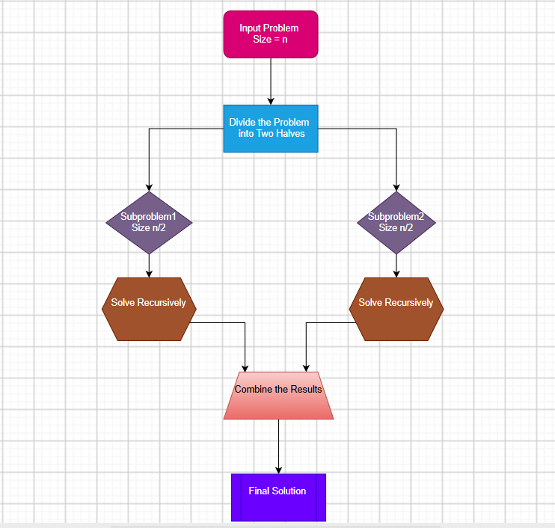
SYSTEM ARCHITECTURE

Slide 7
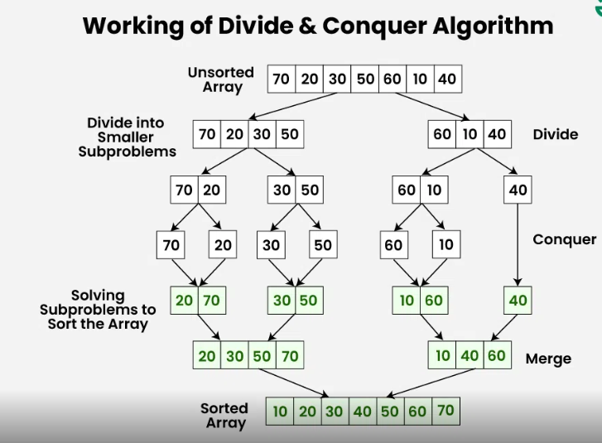
TOOLS/TECHNOLOGIES USED

Slide 8
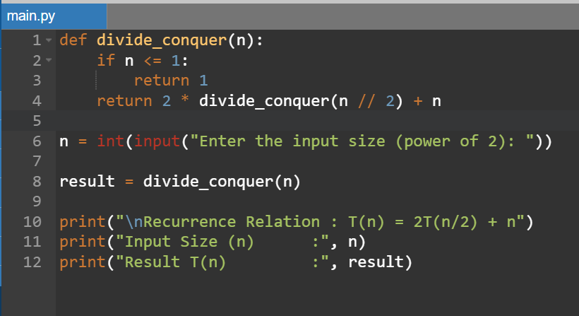
Implementation (Code)

Slide 9
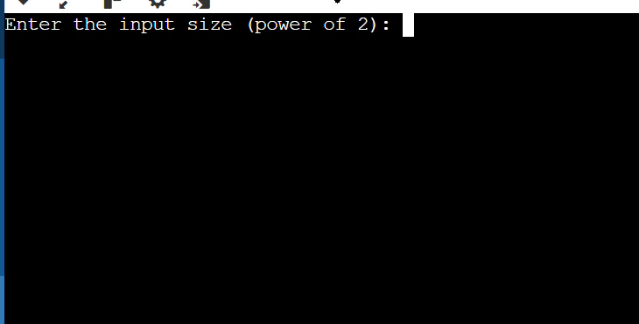
OUTPUT

Slide 10
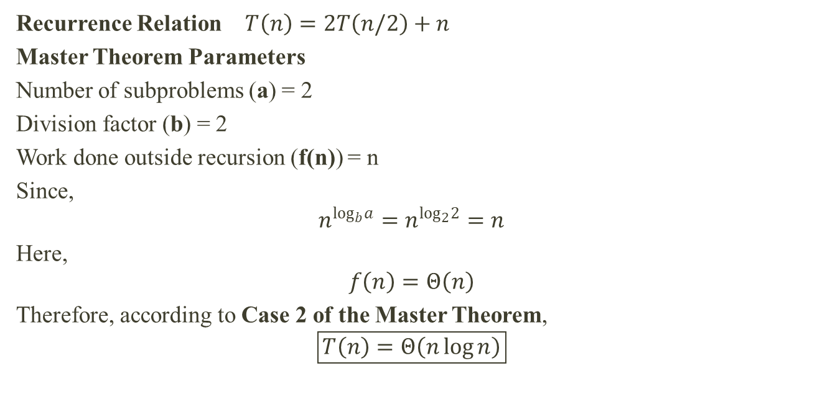
Complexity Analysis
Recurrence Relation $T\left(n\right)=2T\left(n/2\right)+n$
Master Theorem Parameters
Number of subproblems (a) = 2
Division factor (b) = 2
Work done outside recursion (f(n)) = n
Since,
$$n^{\log_{b}a}=n^{\log_{2}2}=n$$
Here,
$$f\left(n\right)=Θ\left(n\right)$$
Therefore, according to Case 2 of the Master Theorem,
$$\boxed{T\left(n\right)=Θ\left(n\log{n}\right)}$$

Slide 11
FUTURE SCOPE
Parallel Processing: Divide and Conquer algorithms can be enhanced using multi-core processors and parallel computing to achieve faster execution.
Large-Scale Data Processing: The approach can be applied to efficiently process big data, cloud computing, and distributed systems.
AI and Machine Learning: Divide and Conquer techniques can optimize data processing, model training, and search algorithms in AI applications.
Advanced Algorithm Design: Future research can develop more efficient Divide and Conquer algorithms with improved time and space complexity for complex computational problems.

Slide 12
CONCLUSION
The Divide and Conquer approach recursively divides a problem into smaller subproblems.
The recurrence relation T(n)=2T(n/2)+n models the running time of the algorithm.
Using the Master Theorem, the overall time complexity is Θ(n log n).
This approach is efficient and is commonly used in algorithms such as Merge Sort, Quick Sort, and Binary Search.

Slide 13
REFERENCES
Thomas H. Cormen, Charles E. Leiserson, Ronald L. Rivest, Clifford Stein, Introduction to Algorithms, 4th Edition, MIT Press.
Ellis Horowitz and Sartaj Sahni, Fundamentals of Computer Algorithms. Alfred V. Aho, John E.
Hopcroft, Jeffrey D. Ullman, The Design and Analysis of Computer Algorithms.
Course Notes – Design and Analysis of Algorithms (DAA).

Slide 14


